Slide 1
DATA-CAN PPIE Meeting “From consultation to dataset” PART 2 – Data, beyond caring for you
“Where your data goes”
“National data”

Slide 2
Data use, beyond caring for you
From your GP record
From your Hospital
National activity
Cancer Registration
And the benefits that this brings….. (a taster)

Slide 3
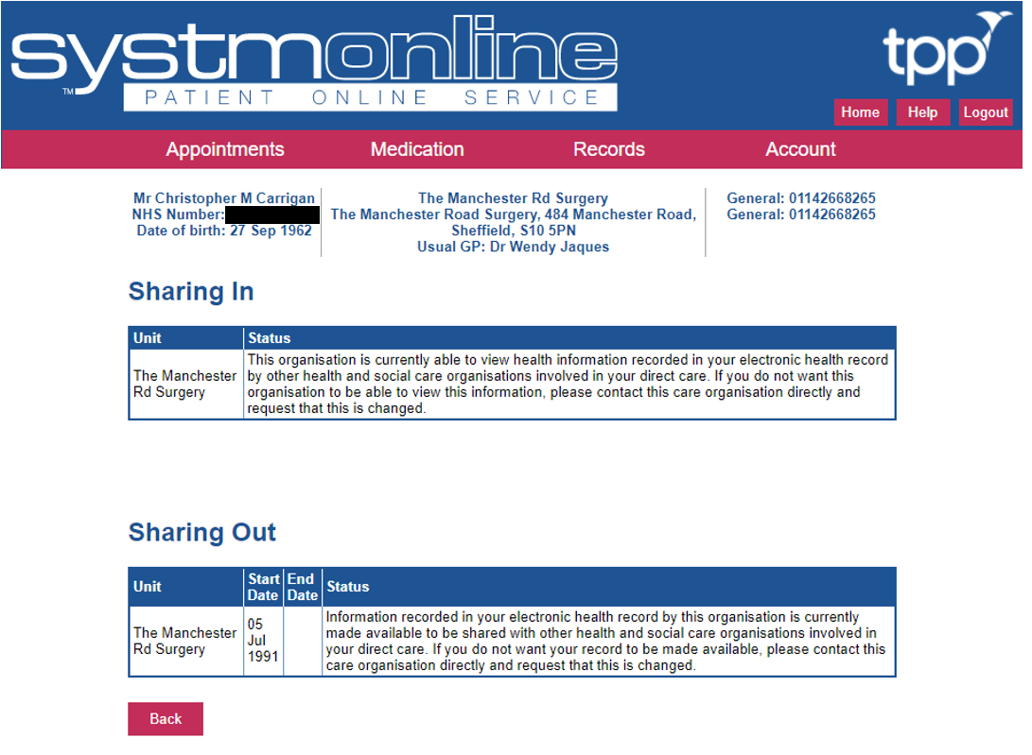
Where does your GP data go?
GP Payment
List size, deprivation, health checks, health promotion, visits, training
Research databases
Prescribing, observational studies
Summary Care Record
Shielded Patient List
“Emergencies”

Slide 4
Where does your Hospital data go?
Health bodies who hold “activity” data
NHS Digital
NHS Wales Informatics Service (NWIS)
Public Health Scotland
Commissioning Support bodies**
Other organisations hold cancer data
“Cancer registries”
National audits
Cancer Screening**

Slide 5
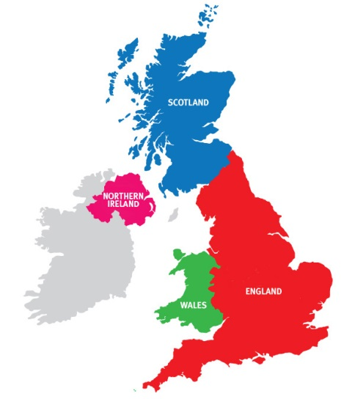
The main types of hospital data
Administrative - Waiting times, Outpatient, Inpatient, A&E, Maternity
Cancer Information Standards (e.g. COSD)
National Cancer Audits
Clinical Trials
“Local” stuff
Many data standards and five audits (at present)
Standards - mandated through NHS National contract and commissioning
National audits - monitored through CQC and Quality Surveillance Programme
Notes:
NABCOP, NBoCA, NLCA, NOGCA, NPCA,

Slide 6
Where to find Data Standards
Some data standards:
CWT - Cancer Waits
RTDS – Radiotherapy
SACT – Chemotherapy
DID – Diagnostic imaging
COSD – Cancer Outcomes and Services
COSD incorporates key audit fields and CWT fields
England – NHS Data Dictionary (HSCIC)
Wales – NHS Informatics Service (NWIS)
Scotland - National Data Catalogue (ISD)
NI - Health & Social Care Board, Information Standards Service

Slide 7
National audits
Healthcare Quality Improvement Partnership (HQIP)
NABCOP - National Audit of Breast Cancer in Older Patients (RCS CEU and ABS)
NBoCA – Bowel (RCS CEU, ACPGBI and NHS Digital)
NOGCA – Oesophago-gastric (RCS CEU)
NLCA – Lung (RCP)
NPCA – Prostate (RCS CEU and NCRAS)
https://www.hqip.org.uk/a-z-of-nca/
Others which have transitioned
HANA – Head & Neck (run through Saving Faces)
Majority of audit data is also collected through COSD

Slide 8
Activity data
Cumulative
Replicated*
Activity is grouped by:
Episodes of care (e.g. Hospital Episode Statistics – HES)
Cost groupings (e.g. Healthcare Resource Groups – HRG)
Data is used for things like:
Invoice validation**
Risk Stratification**

Slide 9
Cancer Registration

Slide 10
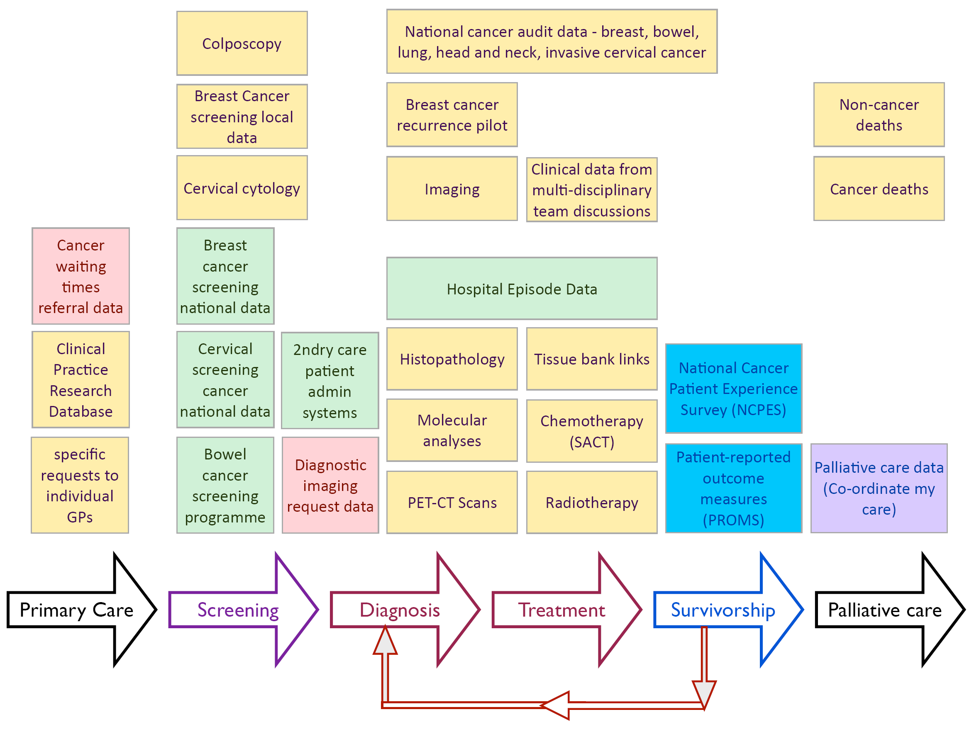
It’s complicated…
ONS data
Source: Public Health England

Slide 11
What does the clinician get back, when?
Level 1 Report
NCRS Reporting Portal
Level 2 Report
NCRS Reporting Portal
Level 3 Report
NCRS Reporting Portal
NCRS
NCRS
NCRS
Process Data
JAN
FEB
MAR
APR
MAY
JUN
JUL
AUG
NOV
DEC
AUG
SEP
OCT
NHS Trust
PAS
COSD / Path
JANUARY Data

Slide 13
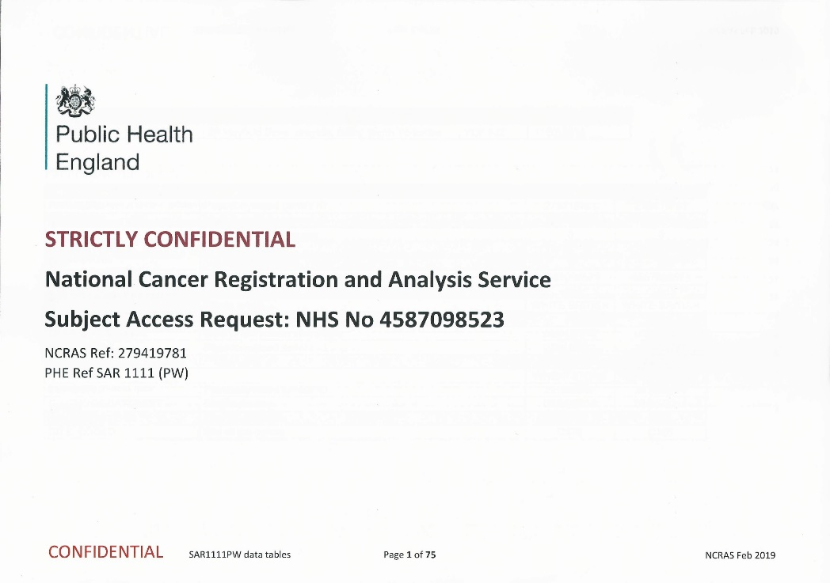
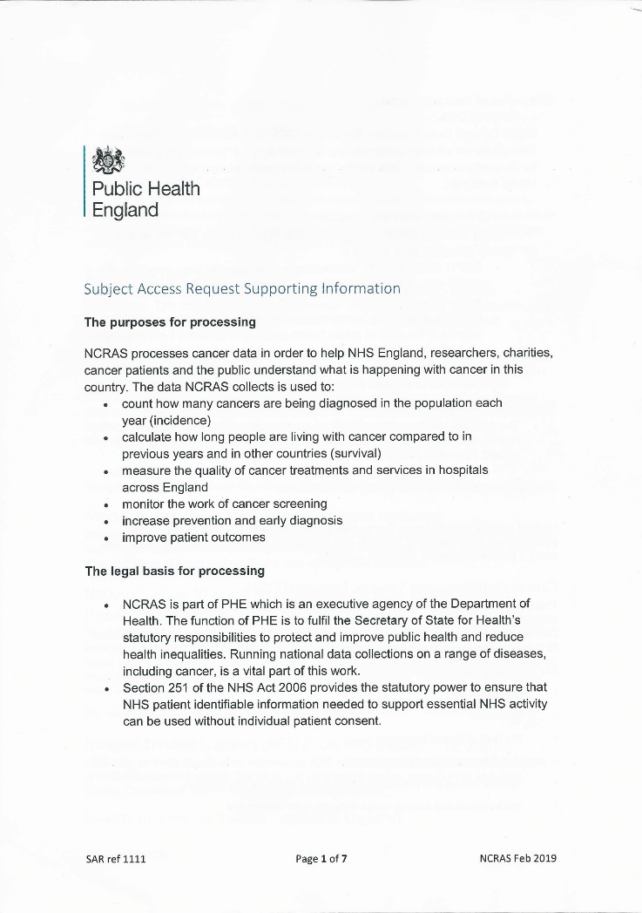
My Cancer Data

Slide 14
What Did We Find?

Slide 17
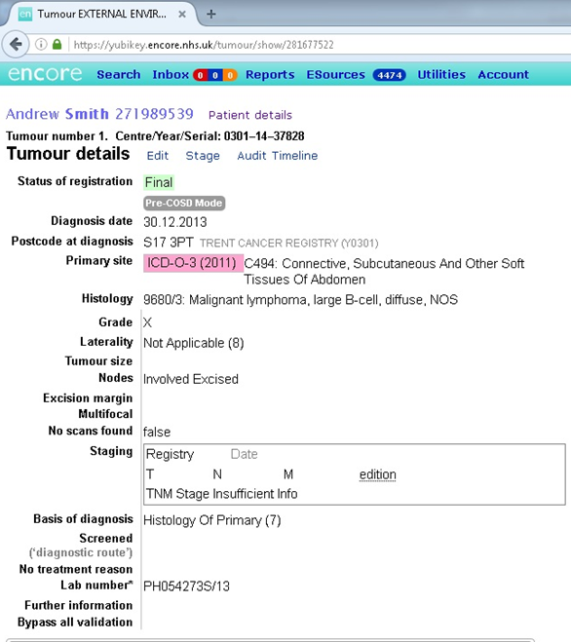
Summary cancer registration record is created by National Cancer Registration Service

Slide 18
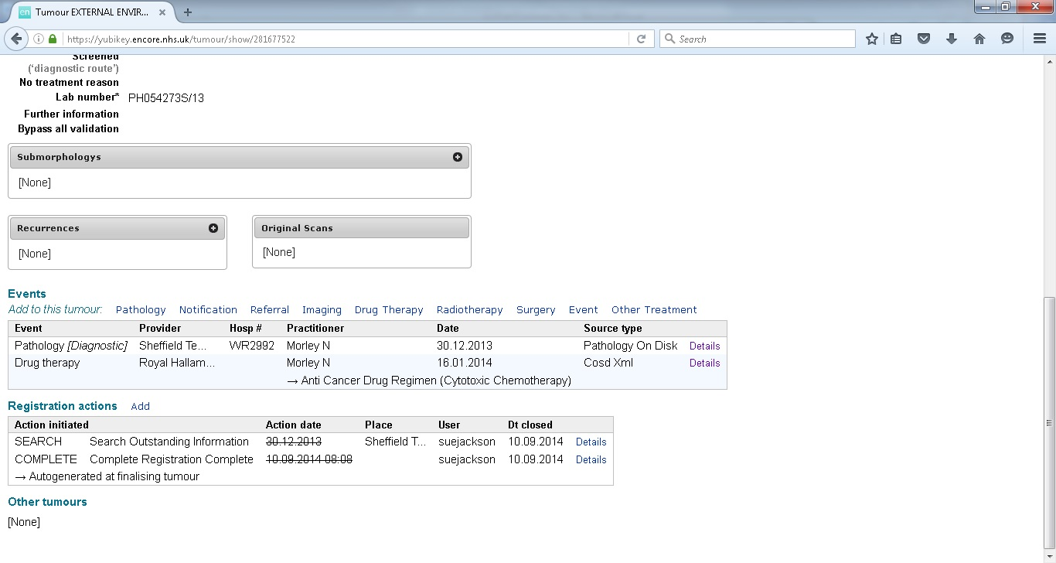

Slide 19
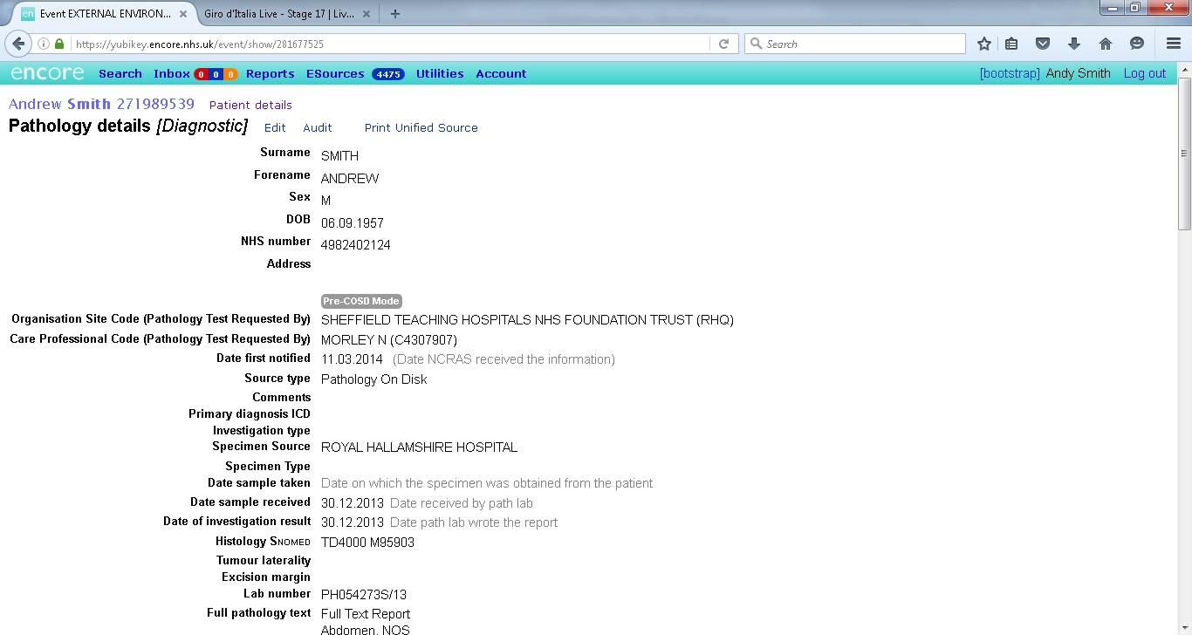

Slide 20
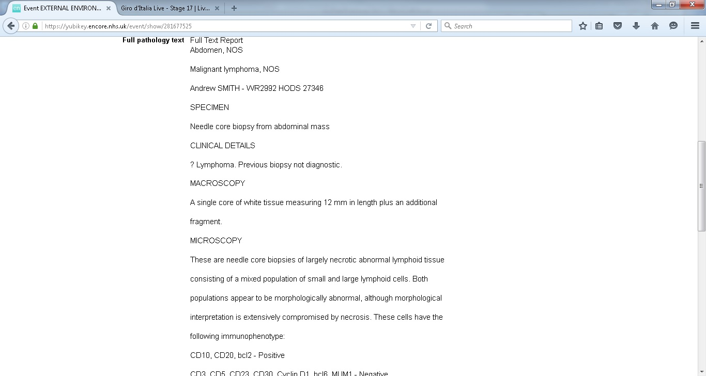

Slide 21
Subject Access Request -What Did We Find?
Significant DQ improvements from ‘Data Tom’ exercise in 2013
A few inconsistent uses of codings
Some chemotherapy missing (one entire month)
Some clearly erroneous codes
Nothing of real significance noted apart from 1 item
Pete’s data has been used externally by 10 organisations
Personally Identifiable – 2 organisations (supplied on 3 occasions)
De-personalised – 8 organisations (supplied on 18 occasions)
Pete’s data has been used internally by the Registry analysts

Slide 22
And finally, a taster of data-usage…..

Slide 23
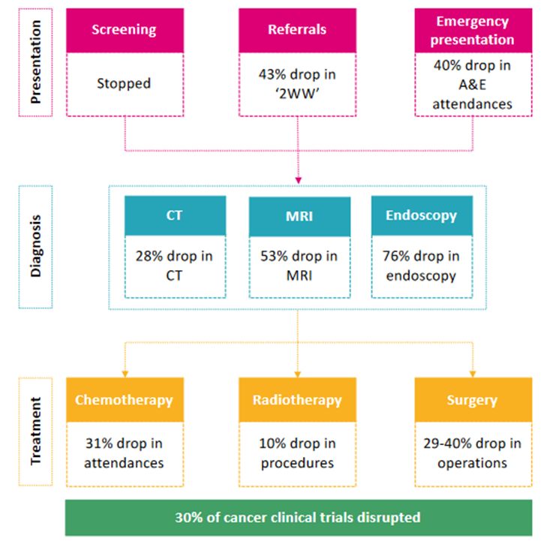
Covid and cancer - What the data can tell you?
Source: https://www.carnallfarrar.com/media/1570/200813-recovering-cancer-from-coviddocx.pdf

Slide 24
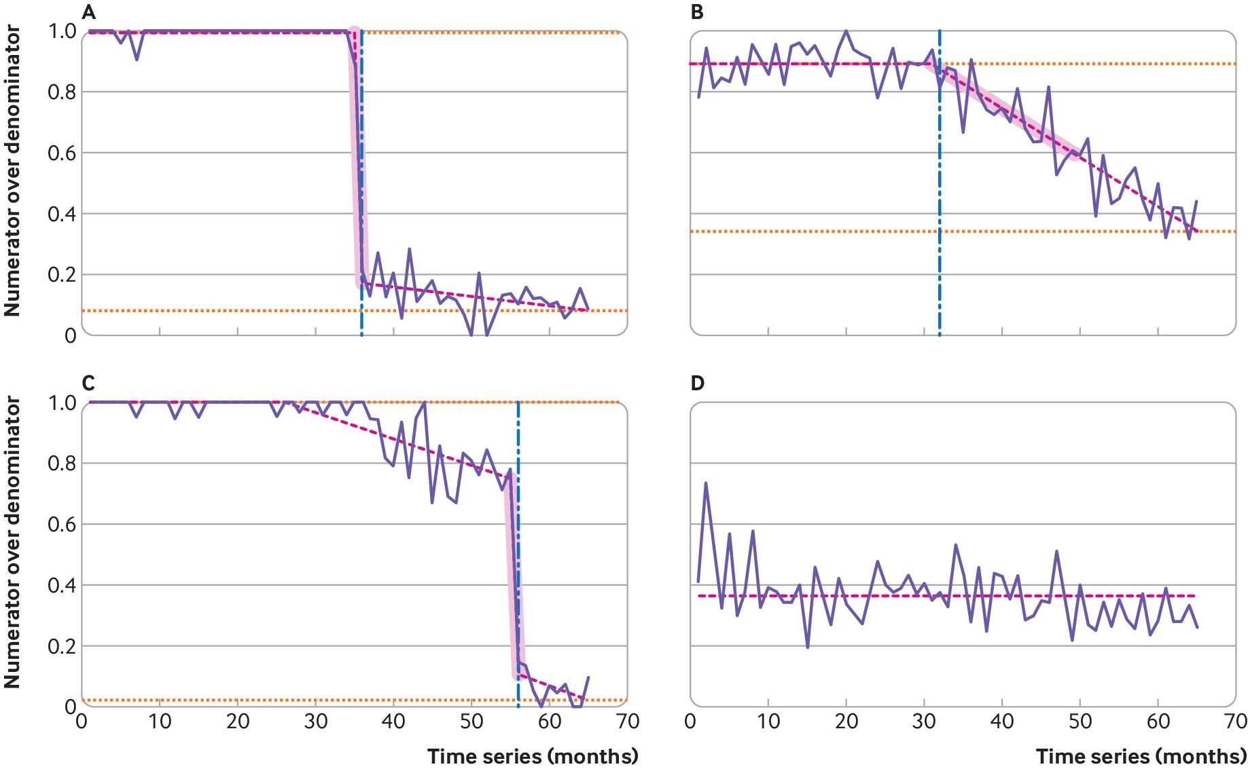
Examples of practice time series and measured attributes for desogestrel change (from branded to generic).
Alex J Walker et al. BMJ 2019;367:bmj.l5205
©2019 by British Medical Journal Publishing Group
Notes:
Examples of practice time series and measured attributes for desogestrel change (from branded to generic). Proportion of Cerazette relative to total desogestrel prescribed of four representative general practices is shown in solid purple lines. Fitted model and detected breaks using trend indicator saturation are shown in pink dashed lines. Commencement of the largest negative shift is marked with a vertical dashed blue line; additional breaks are indicated by changes in the slope of the pink dashed line. The measured slope is highlighted in pink shaded areas, and the pre-break level and final level at the end of the sample are indicated by horizontal orange dotted lines

Slide 25
Questions?

